Slide 1
Polyphinite
March 30, 2018
A new method of composition
for the 21st century Composer.
www.zachdaniels.com/polyphinite
Notes:
Hello! Welcome to my DMA lecture recital.
All pertinent materials for this presentation are currently available via the link on the screen, www.zachdaniels.com/polyphinite. For those that have handouts, but would like a perusal score, you may find one on the webpage near the bottom. Before we begin, I would like to thank my performers, Anthony Conroy and Leonor Javier, for dedicating their Friday evening and plenty of late nights in Dr. Lamb’s studio to help bring this music to life for you tonight. I would also like to thank my primary instructor, Dr. Marvin Lamb, for helping me through this process as I designed this method, wrote the rules, and at times struggled to bring my ideas to fruition. I would also like to thank Dr. Karathanasis as my secondary instructor. His comments throughout the past two years of developing Polyphinite have been very valuable and at times helped settle minor disagreements between Dr. Lamb and myself over how best to proceed with the project. Thanks also, to my committee members: Dr. Jeff Swinkin, Dr. Michael lee, and Dr. Judith Pender for agreeing not only to serve on my committee for three years, but help launch me into my career as an academic and composer. I’m not entirely certain why they said yes, but hopefully at the end of all this they end up having had as much fun as I’ve had. Finally, I would like to thank my colleagues here at the University of Oklahoma for listening to me talk…. A lot about this project since I began work on it in 2016.
What if I had a piece of music, for string quartet, that was all set and ready for the premiere? Now, what if the second violin gets sick and cannot play? Your amazing new magnum opus will not be useful for this group at the gig. What if, however, the string quartet you handed them also had a functional string trio, a compelling cello solo work, and an exciting duet for violin and viola? The gig is saved, you keep the performance, and your piece of music just proved to be incredibly useful despite missing a major component: one of the four performers. Not to mention, you still get to report the work to ASCAP or BMI as having been performed. This is but one of the benefits to Polyphinite.
(next slide)

Slide 2
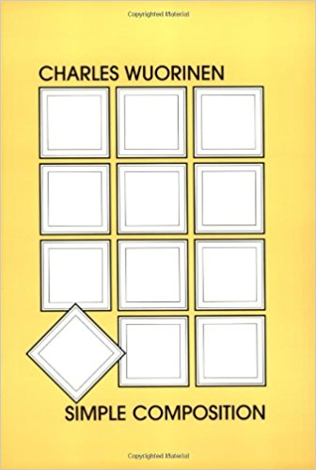
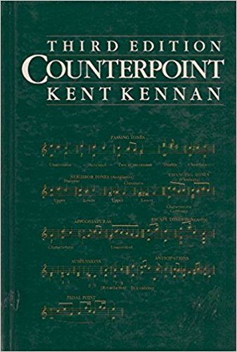
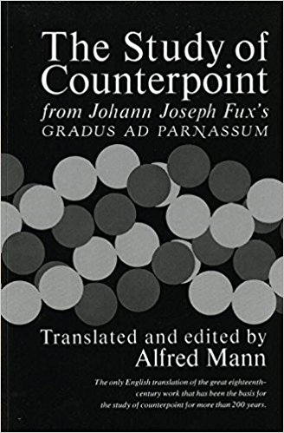
Compositional methods
Notes:
Why a new compositional method?
There are many existing methods for composition that we use today.
We have Twelve-Tone,
as developed by Arnold Schoenberg in the early part of the twentieth century, (click)
and continued by composers today such as Charles Wuorinen – who even has a composition textbook that focuses heavily on twelve-tone and serialism: Simple Composition, 1979.
There are also the time-tested Counterpoint methods,
as written extensively about by Joseph Fux hundreds of years ago in his text: “Gradus Ad Parnassum”. (click)
This highly important text in the composition world was translated by Alfred Mann in 1965.
More recently, counterpoint has had a textbook written by Kent Kennan, (click)
“Counterpoint”.
(Pick up Book)
In the preface to his book on counterpoint, Kennan says the following:
Read Kennan, p. vii third paragraph
Now, building on Counterpoint and using ideas developed by early serialists such as Schoenberg, and his students Berg and Webern: I proudly present Polyphinite. (click)

Slide 3
What is Polyphinite?
Acts as an Extension to Counterpoint
Encourages the use of serial technique as a means of creating music
Creates a set of works that are easily interchangeable within an ensemble type
Keeps performers engaged
Unifies a set of works that would otherwise come off disjointed and unrelated
Inf
inite
Polyph
ony
Notes:
What IS Polyphinite, anyways?
Polyphinite, in simplest terms, is a new method I have been developing for the writing of music in the twenty-first century as an extension to conventional contrapuntal methodologies.
The name, while not the most elegant of names, is very telling of the system’s goals.
(click)
It is heavily polyphonic in nature, and one could argue that the writing would become infinitely more complex as you add more and more parts to it.
(click)
(look at screen)
Infinite Polyphony. Sounds terrible, though not as bad as Infiniphony. (pause) Yes, that was briefly considered. I then settled on the name “Polyphinite” (click)
as a means of combining the two ideas into one succinct word. (pause) This is the spelling that was found least offensive to the eyes.
(click)
Inventing words is never a good idea.
(click)
Polyphinite acts as an extension to counterpoint, it is not to be considered as an outright replacement. (click)
Polyphinite encourages the use of serial technique as a means of creating music, and as a means of creating unity between different parts of the work. (click)
With Polyphinite, I seek not to replace these long-standing methodologies as a tool, but to give a new perspective on the subject and take counterpoint to the Nth degree. (click)

Slide 4
Background
First major piece after finishing my Masters Thesis, “Immortal”.
Tasked to write an unaccompanied solo using serial technique
I quickly settled on the <014> PC-set
Notes:
So what lead me to Polyphinite? (click)
I was debating what to compose next after completing my Masters Thesis, (click)
and my advisor, Dr. Lamb, recommended a new, unaccompanied work for solo instrument written in a serial manner. (click)
I quickly settled on using the 014 Pitch-Class set, as many composers have done in the past hundred-plus years. (click)
For those that do not know what I mean when I talk about Pitch-Class sets…(click)

Slide 5
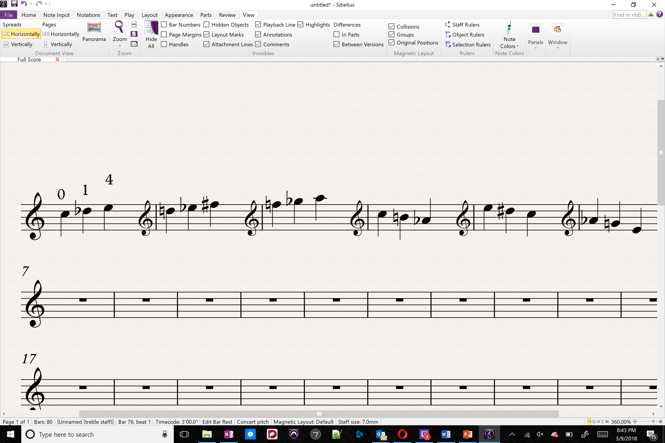
Notes:
So what lead me to Polyphinite?
I was debating what to compose next after completing my Masters Thesis,
and my advisor, Dr. Lamb, recommended a new, unaccompanied work for solo instrument written in a serial manner.
I quickly settled on using the 014 Pitch-Class set, as many composers have done in the past hundred-plus years.
For those that do not know what I mean when I talk about Pitch-Class sets…(click)
the 014 set is essentially C-C#-E, which may be transposed, (click)
inverted, (click)
retrograded, (click)
or even transformed with a compound method using any combination of these operations.
These basic tools of serial composition are adopted heavily in the writing of this project…. (click)

Slide 6
Background
First major piece after finishing my Masters Thesis, “Immortal”
Tasked to write an unaccompanied solo using serial technique
I quickly settled on the <014> PC-set
Struggled to finalize what instrument it was for.
Notes:
Having settled on the 014 Pitch-Class set, I then struggled to decide on an instrument I wished to write for. (click)
So many wonderful choices to choose from... (click)

Slide 7
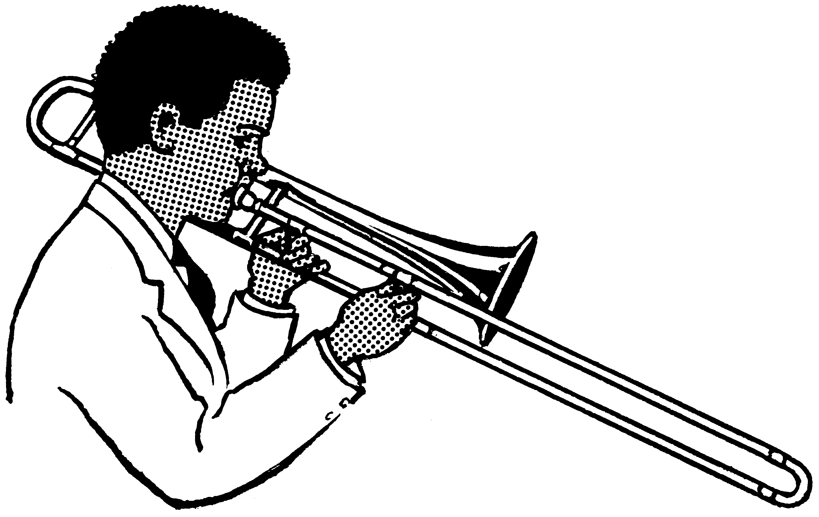
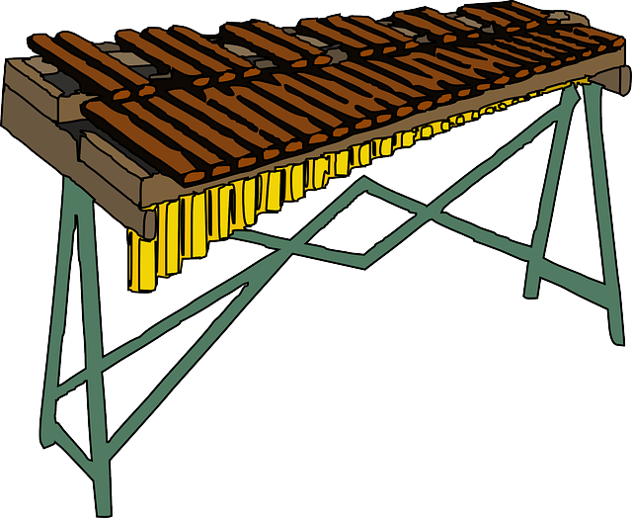
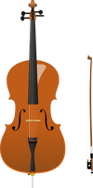
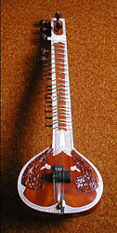
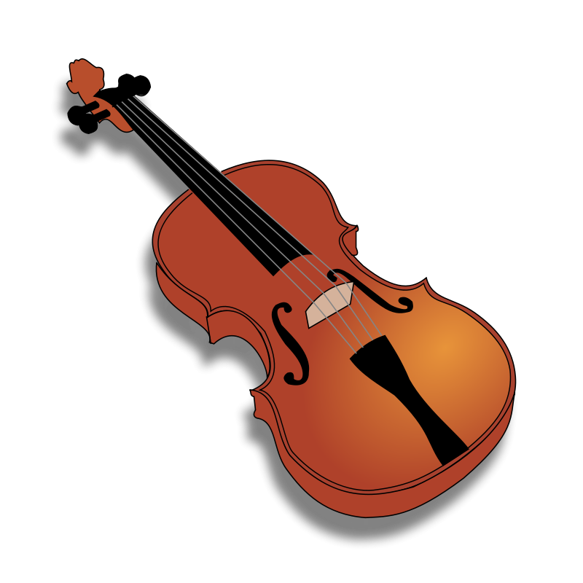

This Photo by Unknown Author is licensed under CC BY-SA
Notes:
Having settled on the 014 Pitch-Class set, I then struggled to decide on an instrument I wished to write for.
So many wonderful choices to choose from... (click)
I considered writing for Trombone, as a result of my recent exposure to Luciano Berio’s Trombone Sequenza. (click)
I also considered the Marimba, as I have long thought of Marimba as the most under-utilized instrument by today’s composers. Such a wonderful instrument. (click)
I even considered viola…. Or violin, let’s be honest you cannot tell from that picture I chose. (click)
Citar, (click)
toaster, (click)
I was having a rough time deciding. (click)
Then, I settled on the cello. (click)
Cello made sense, as I began as a cellist back in 6th grade and I could easily work out complex parts, and I had yet to write a cello solo since my first…. Effort-filled attempts back in high school.
This was conceived as the first solo work in what I was initially intending to be a set of unaccompanied solo works for varied instrumentation – following in the footsteps of composers such as Luciano Berio or Paul Hindemith.
In short, I simply wished to expand my solo repertoire. (click)

Slide 8
Background
First major piece after finishing my Masters Thesis, “Immortal”
Tasked to write an unaccompanied solo using serial technique
I quickly settled on the <014> Pitch-class set
Settled on Cello
Conceived as the first solo work in what I was initially conceiving as a set of unaccompanied solo works.

Slide 9
Polyphinite 1, No. 1
For Solo Cello
Notes:
Now, I present the first piece of the Polyphinite puzzle:
Polyphinite No. 1 for solo cello.
Sit Down – 11:00 On Pace
Stand up, Clap, recognize Anthony, and return to Lectern.
(turn to Anthony)
Thank You, Anthony! You are a wonderful friend and colleague for asking me on multiple occasions if you get to play that. Just remember, you signed up for it.

Slide 10
The piece was complete
yet something was missing…….
Notes:
This initial solo work, though perfectly fine on its’ own, felt as though it might be missing something…
What to do…. What to do……
(click)

Slide 11


Extend the Work
Leave it Alone
Add More Layers
&
Notes:
What methods might a composer utilize to properly tackle this problem?
(click)
I could leave it alone. – Sounds Boring
(click)
I could extend the work. – Though… I rather liked the idea of a suite of pieces that were all exactly five minutes long, so this wouldn’t do.
(click)
Adding more layers was the suggestion from Dr. Lamb. – This was the obvious solution to keep me out of trouble.
(click)
I decided to make it harder on myself and combined the first and third options.
What if the cello solo were also half of a duet?
(click)

Slide 12
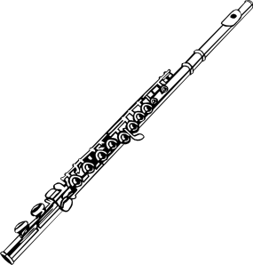
This Photo by Unknown Author is licensed under CC BY-SA
Notes:
So I returned to the question of instruments I could choose from……
I began to think: “What instrument should I write for as part of a duet with the cello?”
I didn’t know anyone with a Citar, and since nobody was willing to let me mutilate their toaster….. I quickly settled on Flute as my instrument of choice.
There are many reasons why I decided on adding flute.
First and foremost, flutists tend to like new music – increasing likelihood of finding someone to participate in this endeavor. Also, it is naturally a good compliment to the cello. The timbral combinations you get from the two instruments – two of my favorite – unlock a lot of possibilities in my music. Finally, my history of writing flute music made it an obvious choice. I knew flutists to contact regarding the project, and already knew the ins and outs of flute writing.
The resultant two-movement work had a strong cello solo, and a strong duet for flute and cello. Both of these pieces had unique characteristics and sonic qualities.
Then I began to think again……. Which is never a good idea after finishing a piece of music…..
“What if the flute were also a solo?”
I revised the flute part to make it more soloistic, adding favorites of mine such as a morse code “S.O.S.” signal, jet whistle, and a few others I enjoy using when writing for flute.
After revising the flute part to make it more soloistic, I found that large portions of the cello had to be rewritten in order to accommodate this new solo flute idea.
Thus began a long process of editing the THREE pieces in conjunction with one another. The amount of detail-work that had to be done to accomplish even the smallest tweak in one part sometimes meant entire gestures either were lost or drastically changed in the other two works.
Finally, I had succeeded. I had finished the second piece of the Polyphinite puzzle: Polyphinite no. 2, for solo flute.

Slide 13
Polyphinite 1, No. 2
For Solo Flute
Notes:
Sit Down – 18:00 is On Pace
Stand up, Clap, recognize Leonor, and return to Lectern.
(turn to Leonor)
Thank You, Leonor! You have just been awesome to work with these past months.
(turn to Audience)
She actually responded to my inquiry with the phrase: That sounds awesome! When’s the performance?
(turn to Leonor)
Hopefully she is that enthusiastic about new music after this is all set and done.

Slide 14
Flute, Violin, Clarinet, and Cello
14 Works
First Polyphinite Collection.
Notes:
After observing the success of the Flute and Cello experiment, I decided I wanted to push the idea to the next level. I initially decided on trying to write for Pierrot Ensemble plus percussion in this style. Utilizing percussion would also unlock a great deal of color and timbral options, and the University has such a wonderful percussion program. It made sense!
However, I quickly realized that it would be best to limit the scope of the ensemble since I was unsure of what it was I was doing with the project at the time.
I settled on using just the Flute, Violin, Clarinet, and Cello from the traditional Pierrot Ensemble instrumentation, (click) leaving out voice and piano from the original instrumentation of Pierrot Ensemble’s namesake: Schoenberg’s acclaimed “Pierrot Lunaire”.
(click)
The resulting 14 works would become the first Polyphinite Collection.
(click)
As you can see from this score sample, I make use of

Slide 15
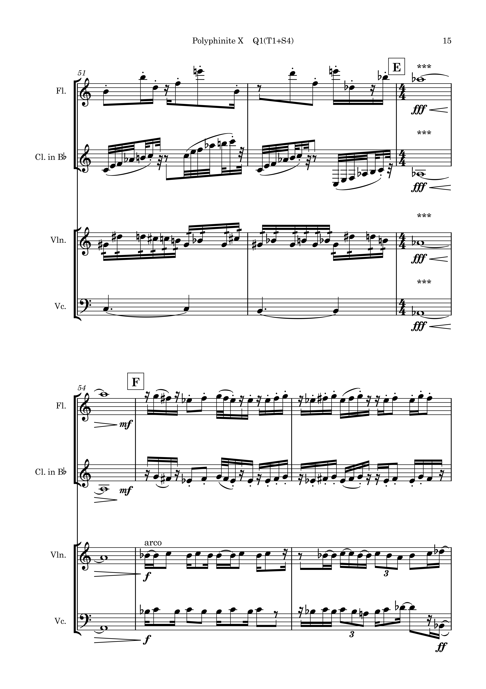
Notes:
Rhythmic Cadenza at [E]

Slide 16
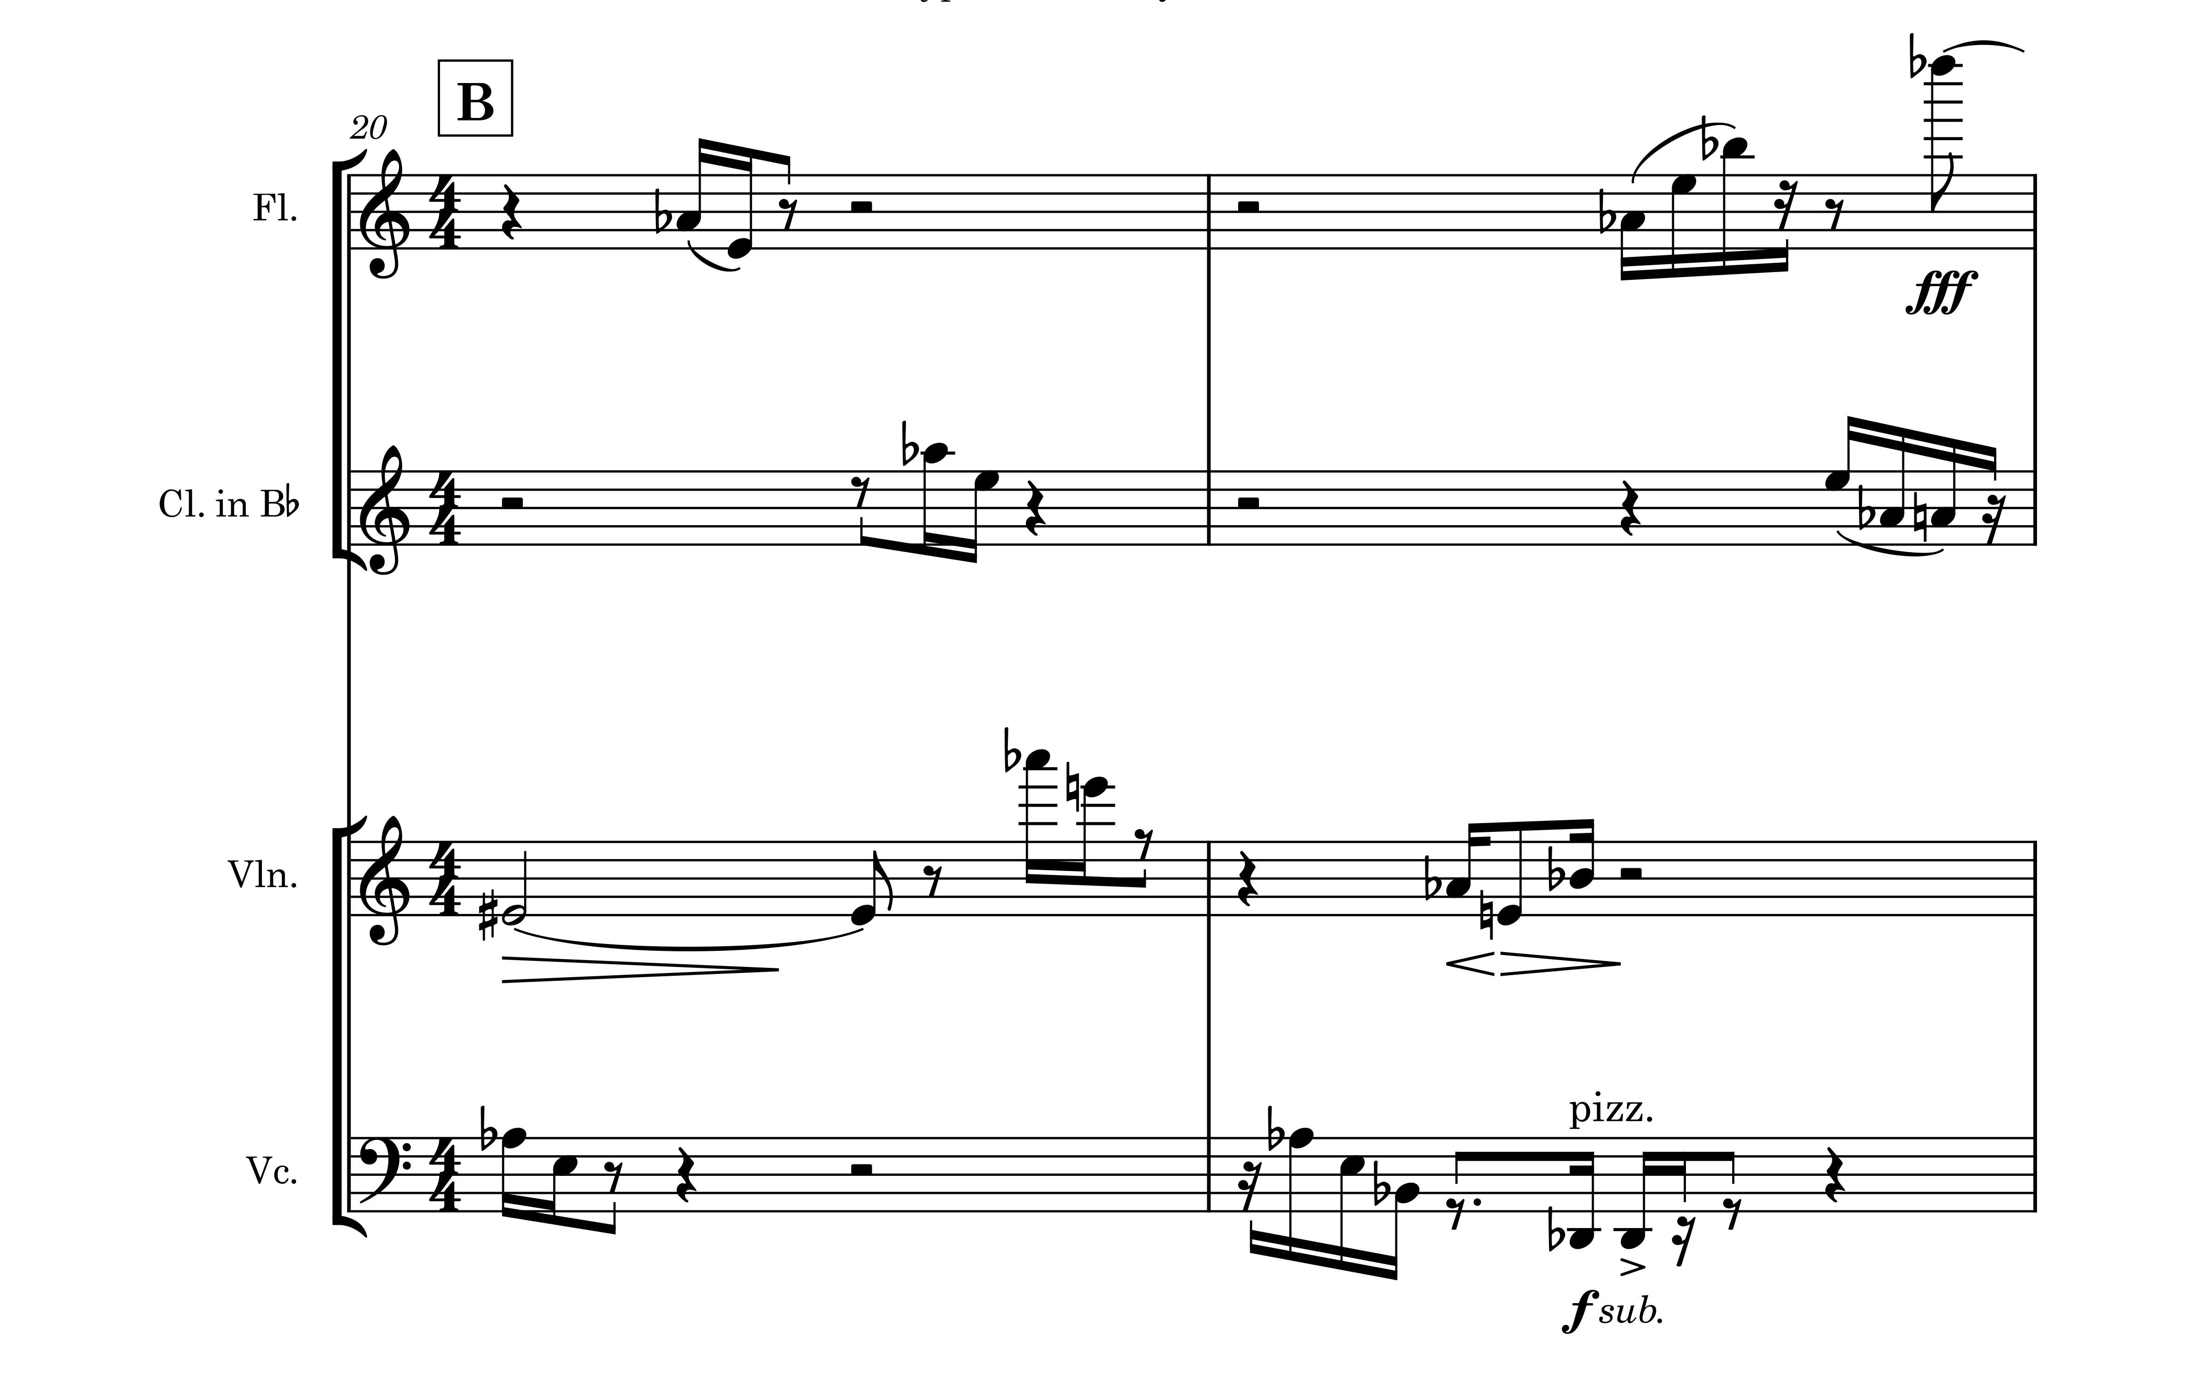
Notes:
Sparse Textured Areas, such as measures 20 & 21 come off as resonant in the solo iterations, and pointillistic in fuller ensemble iterations.

Slide 17
Notes:
Imitation between the violin and cello at [F]

Slide 18
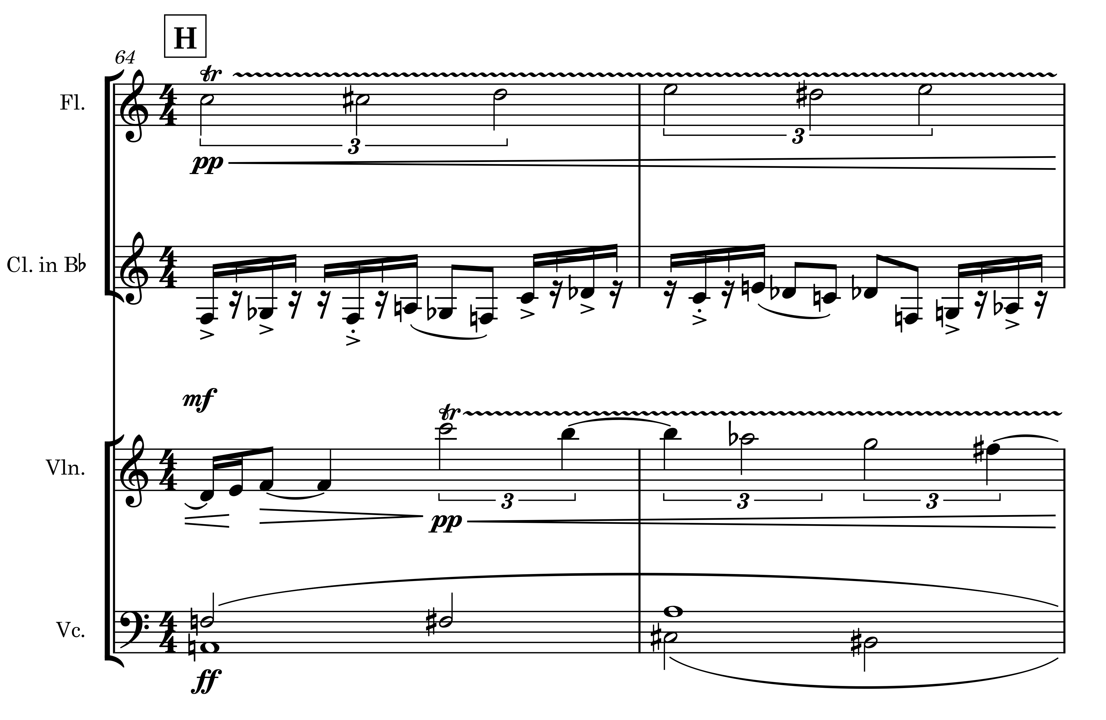
Notes:
Several different beats to follow in this excerpt from the full quartet.
¾ feel in clarinet
Slow 4/2 feel in Cello
Slower 3 feel in flute
Violin is also playing a slow three, though a half-note off from the flute.

Slide 19
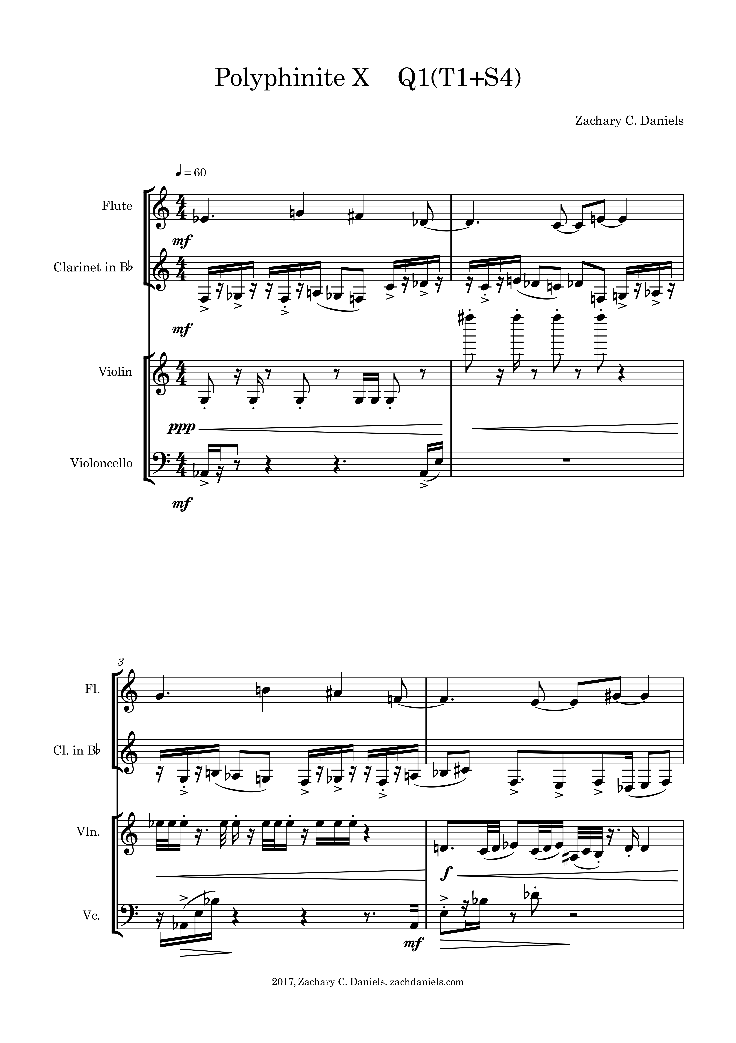
Notes:
Finally, the naming scheme….
The naming looks like a Chemistry Equation. I promise it’s much simpler than that. The Q1 states that this is Quartet 1 from here on out. The T1 + S4 means you are to combine the Trio 1 (Flute, Clarinet, and Cello) with Solo 4 (Violin). The greatest iteration of Polyphinite is designated “X” because there is no way of guaranteeing that this will always remain the greatest iteration in a collection.
In writing this project, I ended up with a set of rules to guide me when writing in the Polyphinite style, aptly named… (click)

Slide 20
Rules for Polyphinite
Rule 1: Polyphinite works should be composed for a minimum of two parts, up to the maximum instrumentation of a given traditional instrumental ensemble.
Rule 2: Each part must have an equal amount of time passage from beginning to end.
Rule 3: All elements of music, such as pitch, rhythm, dynamics, tempos, and manifestations of these such as meter do not change for the individual parts.
Rule 4: Composers should seek balance between contrapuntal gestures and timbral/textural interactions found in the ensemble iterations, and the individuality of solo gestures.
Rule 5: Electronic elements (such as a fixed media track) may be included, but must follow the same rules as instrumental solo works given above.
Rule 6: The focus should be on creating a strong set of solos, and focusing on the largest ensemble.
Notes:
The Rules for Polyphinite. Original, right?
(click)
The First Rule of Polyphinite:
Polyphinite works should be composed for a minimum of two parts, up to the maximum instrumentation of a given traditional instrumental ensemble, such as band, string quartet, reed quintet, or orchestra.
(click)
The Second Rule of Polyphinite:
Each part must have an equal amount of time passage from beginning to end. That is to say, you cannot have a 5 minute cello solo under a three minute flute solo that starts two minutes late, or ends two minutes early. As an example, in my Polyphinite Collection: each work that is a part of it clocks in at 5 minutes exactly.
(click)
The Third Rule of Polyphinite:
All elements of music, such as pitch, rhythm, dynamics, tempos, and manifestations of these such as meter do not change for the individual parts, whether being realized as a solo, duet, trio, quartet, or greater iteration.
(click)
The Fourth Rule of Polyphinite:
Composers should seek balance between contrapuntal gestures and timbral/textural interactions found in the ensemble iterations, and the individuality of solo gestures.
(click)
The Fifth Rule of Polyphinite:
Electronic elements (such as a fixed media track) may be included, but must follow the same rules as instrumental solo works given above. I was not brave enough to attempt this, but if any of my colleagues in attendance today wish to try, you are better than me. If you succeed, then I’ll personally pay the bill for the mental hospital you undoubtedly put yourself in. Should you not go insane from this, please teach me.
(click)
The Sixth Rule of Polyphinite:
The focus should be on creating a strong set of solos, and focusing on the largest ensemble. While not ideal, the “middle” ensembles should be thought of as lower priority in this method. It is possible that some ‘middle’ iterations might be weaker than the others.
The following is only the first of 6 given duets using this method and ruleset, Polyphinite No. 5 (D[1+2])
(click)

Slide 21
Polyphinite 1, No. 5 for Flute and cello
Notes:
Sit Down – 18:00 is On Pace
Stand up, Clap, recognize performers, and return to Lectern.
Thanks guys, You Rock!
It should be noted that I was initially going to present the entirety of Polyphinite during this recital, but Dr. Lamb advised me that forcing an hour and 15 minutes of Polyphinite on my audience wouldn’t go well. After this conversation, I decided that doing a selection of pieces from Polyphinite works well up to three selections back-to-back. This way, you get two solos and a larger subset of Polyphinite as a small suite of related works. This ensures variance and allows for differentiation in programming should anybody take a Polyphinite collection on tour.
(click)

Slide 22
Where is Improvement Needed?
Notes:
Revisions: Where is improvement needed?
(click)
1) The greatest iteration of this endeavor (that which includes all members of the ensemble) should be written with each solo in mind, with the following principles in mind while revising previously written parts. To that end, I mentioned that some middle iterations of Polyphinite may be weaker than the solos and full ensemble iterations. In my piece, this is no exception. I know the weakest member of my Polyphinite Collection I presented today to be the duet for Flute and Violin. This is partly due to the range similarities in parts I wrote, and also my sparse use of the low-end in the violin to accommodate this combination. Were I to write the piece again, I would seek a solution to this above all else.
(click)
2) In this first attempt, I did not yet realize that the use of extended technique actually makes such an endeavor easier. Extended techniques add a wider variety of sounds that can be used both alone and in conjunction to create interesting moments that break away from the standards of the rest of the work. Additionally, certain extended techniques create a higher level of interest to a listener, which would allow for better enjoyment of a piece. In future iterations of this, I would encourage the use of extended technique to create further variance within each work
(click)
3) Expressions and tempo alterations can be used to allow minor variances in interpretation that would allow for better coordination of the multiple parts while still staying true to the ideas of Polyphinite. (samples in powerpoint)
(click)
Some Examples:
a. Accel. – Rit. Over Rit. – Accel. Over same space (click)
b. Rubato section of sparse textures (click)
c. Softly has variability in interpretation. (click)
(click)
4) It sounds mechanical at times. This is likely something that resulted from my focus being split between writing the piece itself, and attempting to create a ruleset for the Polyphinite method. However, to avoid this one might write the piece without meter in mind, using meter only as a framing device for the performers after the work is written.
(click)
5) Future iterations of Polyphinite will likely use multiple metered music as a means of creating more distinct solo works that do not follow the same rhythmic design 100% of the time. Perhaps a 6/8 + 2/4 in the flute might be written over a relatively simple 4/4 cello line. SCORE SAMPLE IN POWERPOINT
(click)
Metric modulation, as used extensively by Elliot Carter. An example, in this excerpt from his second string quartet. SCORE Excerpt IN POWERPOINT
Though the same gains could be seen in a piece making extensive use of hemiola or hypermeter as well.

Slide 23
It would be beneficial to compose all solo/ensemble variations alongside each other to remove the need for complete overhauls.
Notes:
1) The greatest iteration of this endeavor (that which includes all members of the ensemble) should be written with each solo in mind, with the following principles in mind while revising previously written parts. To that end, I mentioned that some middle iterations of Polyphinite may be weaker than the solos and full ensemble iterations. In my piece, this is no exception. I know the weakest member of my Polyphinite Collection I presented today to be the duet for Flute and Violin. This is partly due to the range similarities in parts I wrote, and also my sparse use of the low-end in the violin to accommodate this combination. Were I to write the piece again, I would seek a solution to this above all else.
(click)

Slide 24
extended technique
Notes:
2) In this first attempt, I did not yet realize that the use of extended technique actually makes such an endeavor easier. Extended techniques add a wider variety of sounds that can be used both alone and in conjunction to create interesting moments that break away from the standards of the rest of the work. Additionally, certain extended techniques create a higher level of interest to a listener, which would allow for better enjoyment of a piece. In future iterations of this, I would encourage the use of extended technique to create further variance within each work
(click)

Slide 25
Expressive text and tempo variance
Notes:
3) Expressions and tempo alterations can be used to allow minor variances in interpretation that would allow for better coordination of the multiple parts while still staying true to the ideas of Polyphinite. (samples in powerpoint)
(click)
Some Examples:
a. Accel. – Rit. Over Rit. – Accel. Over same space (click)
b. Rubato section of sparse textures (click)
c. Softly has variability in interpretation. (click)
(click)

Slide 26
It sounds mechanical at times.
Notes:
4) It sounds mechanical at times. This is likely something that resulted from my focus being split between writing the piece itself, and attempting to create a ruleset for the Polyphinite method. However, to avoid this one might write the piece without meter in mind, using meter only as a framing device for the performers after the work is written.
(click)

Slide 27
Meter?
Or Lack of Meter
Notes:
5) Future iterations of Polyphinite will likely use multiple metered music as a means of creating more distinct solo works that do not follow the same rhythmic design 100% of the time. Perhaps a 6/8 + 1/4 in the flute might be written over a relatively simple 4/4 cello line. SCORE SAMPLE IN POWERPOINT
(click)
Metric modulation, as used extensively by Elliot Carter. An example, in this excerpt from his second string quartet. SCORE Excerpt IN POWERPOINT
Though the same gains could be seen in a piece making extensive use of hemiola or hypermeter as well.
(click)

Slide 28
Conclusions
Notes:
Conclusions

Slide 29
In the Refining Stages
Needs Testing
Composing without Barlines
Improved Counterpoint Skills
Notes:
This method is currently in the late development stages.
I hope to further refine these ideas
I believe the method to be ready for use
Just needs testing
Improvements in my own music since writing Polyphinite
I now think much more freely about my music, the bar is no longer a crutch
My counterpoint skills have been put to the ultimate test.
I am now much more conscious about the shape of individual lines within a piece of music as I’m writing it.
I now have a stable of unique solo/chamber works that added a great deal to my portfolio.
I would encourage other composers to try at least writing a duet using the Polyphinite method.

Slide 30
Polyphinite 2
Notes:
I’ve been asked about this a lot lately: “Zach, what’s next?”
Ideally, as I previously mentioned, I would like for other composers to consider writing in the Polyphinite method. Even if only for a duet, I feel the benefits are incredible.
As for myself, I guess the only way to take full advantage of the system I’ve created
(click)
is to do it again. By writing a second piece in the newly established system I’ve created, I hope to master the system, further refine my skillset as a composer, and open the doors for others to engage in composition using the Polyphinite method.
(click)

Slide 31
Polyphinite
References:
Kent Kennan, “Counterpoint” third ed.
Reginald Smith Brindle, “Serial Composition”
Bryan R. Simms, “Twentieth Century Music”
Elliot Carter, “String Quartet no. 2”
A new method of composition
for the 21st century Composer.
www.zachdaniels.com/polyphinite
Notes:
I will now take questions.
(take questions from committee members)
We have enough time for one more question probably before we need to end.
(Take Final Question)
Thank You for coming out, everybody! If anybody thinks of questions or decides to try this method in their own work, let me know!
Seeya!

