Slide 1
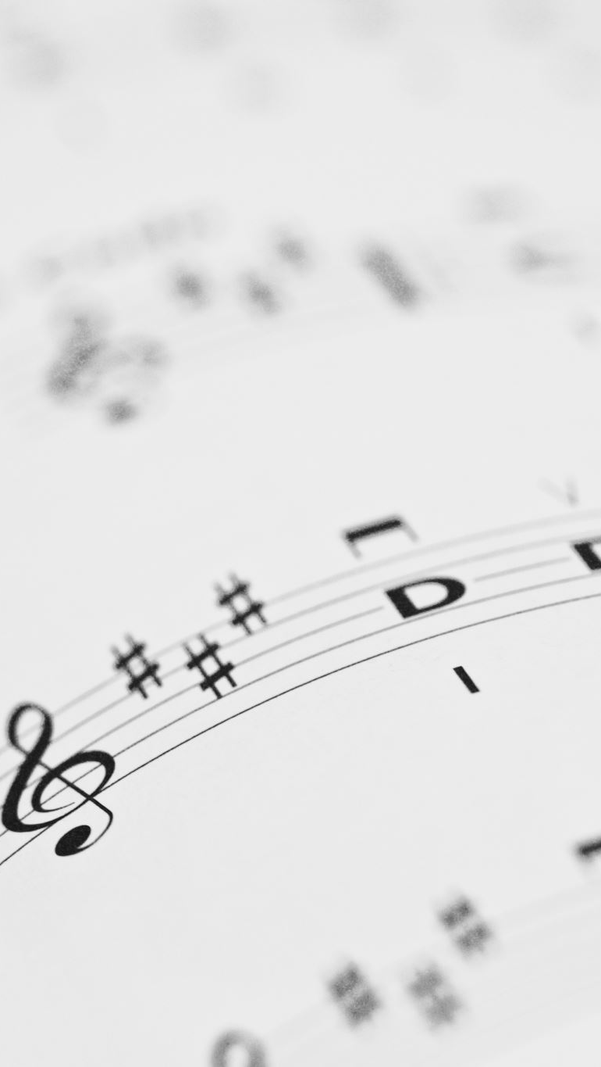
The Granularity of Palindromes
Dr. Zachary C Daniels
Oklahoma City University

Slide 2


What is a Palindrome?
  A Palindrome is defined as a word, phrase, or sequence that reads the same backward as forward. Examples of this might be the word racecar, or phrases such as nurses run or - my personal favorite – taco cat.

Slide 3
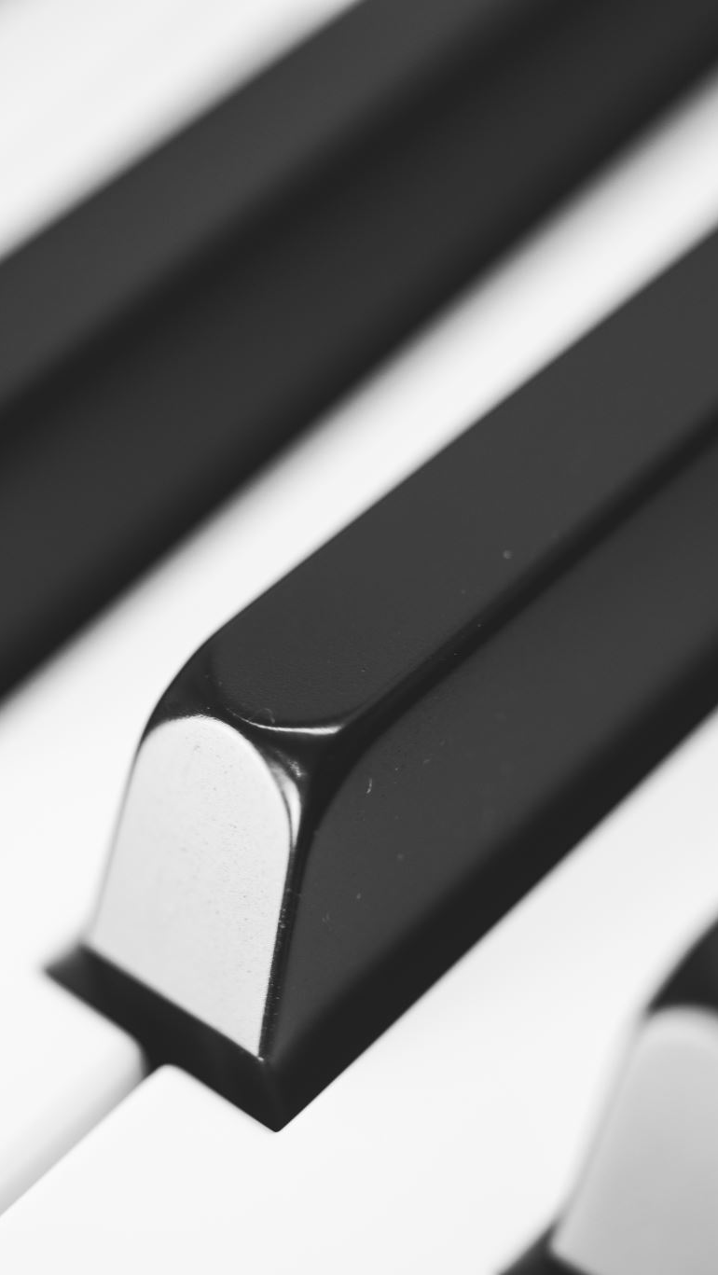
Why Palindromes?
I utilize them quite a lot
The technique fits naturally within minimalism, which I enjoy as a neo-minimalist
Palindromes have a long history in music, and talking about them always draws a lot of intrigue from composers, theorists, and audience members alike

Slide 4

The Questions
What defines a palindrome in music? Does it rely on a notational interpretation? Or how it sounds to the listener?
What about dynamics?
Are rests important?
What if we incorporated ideas of granular synthesis?

Slide 5

Palindromes in Music
A Palindrome in music is a series of notes, a melody ,phrase, or entire work that sounds the same forwards and backwards.
Serialism and 12-tone music often utilize the Retrograde of the prime row which, if heard immediately after, would create a palindrome effect.
This music all would feature some sort of middle-point after which the musical content is presented in reverse. Many call this the middle point or turning point. I propose a new term to more succinctly discuss the forms.

Slide 6

Granular Synthesis in Electronic Music
Granular Synthesis is a form of synthesis based on a process called granulation. Granulation involves breaking down an audio sample into tiny snippets of audio called “grains.” These snippets are typically between 1 and 100 milliseconds long.

Slide 7
Introducing Notational Granularity
Notational Granularity is a note-length by which a musical idea may be divided into for transformational and/or analytical purposes stemming from the idea of a rhythmic grid.

Slide 8
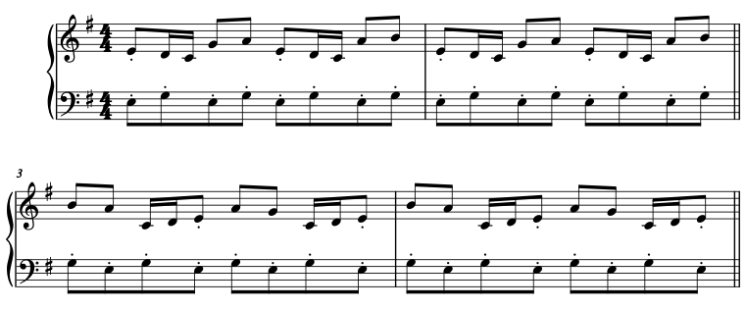

Slide 9
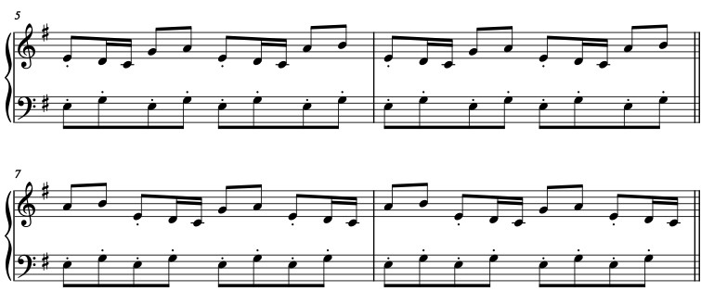

Slide 10
Palindromic Melodies
A Palindromic Melody is a melody that is a palindrome.
Such melodies may be standalone, act in juxtaposition with a bass-line, or act with static or unrelated harmonies underneath.

Slide 11
New Terminology: Fulcrum
The fulcrum is the point at which a musical palindrome begins to reverse itself. This point may be before/after a phrase, or even use a singular note as the point of reflection.

Slide 12
Rhythmic Considerations
In both notational and auditory palindromes, consideration must be given to both the original material, and its’ palindrome, in order to ensure that given music gives the desired effect. One such example might be note-length.
We often focus on when we arrive at a given note, but frequently ignore the release of said note. A small difference, even that such as a double-dotted half-note vs a whole note could make a world of difference as the musical idea, or entire piece passes the fulcrum.

Slide 13
On Rests
Silence is just as important in music as the notes themselves.
Nurses Run
nuR sesruN
Nur Sesrun

Slide 14
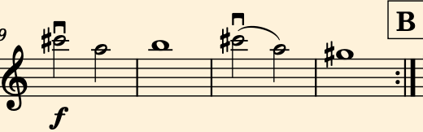
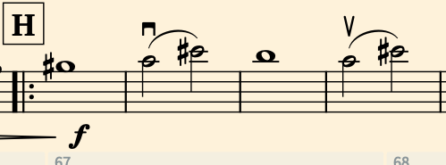
Original, unaltered Version
with Resulting Palindrome

Slide 15
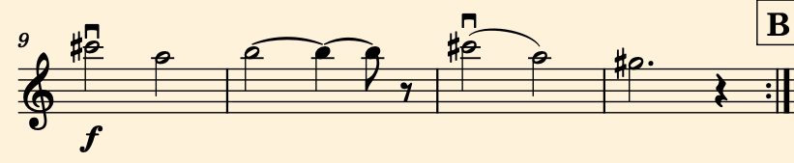
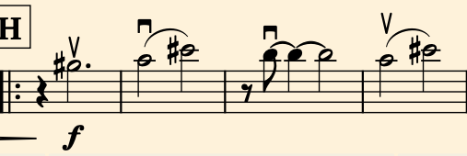
Altered Version
with Resulting Palindrome

Slide 16
Grain Length
If the notational granularity is too large, we don’t get much of a palindrome effect. As an example of this, if we were to create a palindrome with a grain length of 20-30 seconds we could begin to call certain forms such as simple ternary a palindrome.
Ideally grain-lengths should not exceed half a second, or a single note value in the case of longer held notes.

Slide 17
Palindromic Form
Palindromic Form is a form in music wherein the entire piece exists as a palindrome with a fulcrum in the middle.

Slide 18
New Terminology
A notational palindrome is a palindrome that focuses on what is notated on the page.
An auditory palindrome is a palindrome which focuses on the end result heard by the listener, instead of what is written on the page.

Slide 19
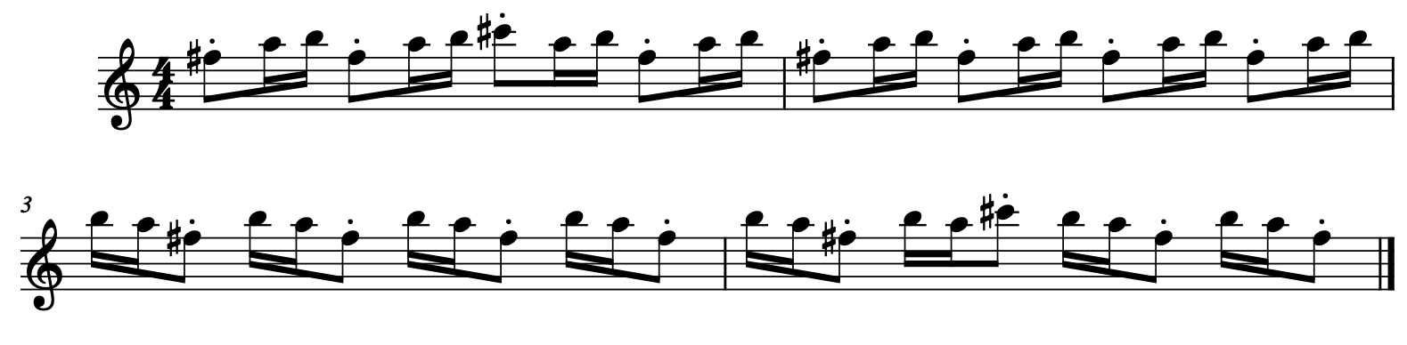
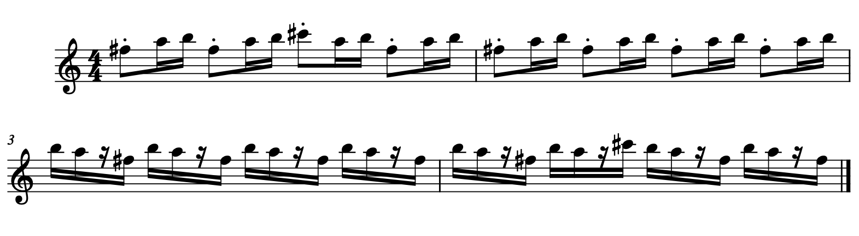
Transforming Notational to Auditory Palindromes

Slide 20

Dynamics Considerations

Slide 21
A Minimal Journey (2021) by Zachary C. Daniels
Written in 2021
Set out to write a minimalist piece for string orchestra
Premiered early 2022 at Missouri’s Music Educators Association Convention
Oklahoma Premiere in February 2022 with Oklahoma Chamber Symphony
Popular educational piece for high schoolers
Teaches minimalism, palindromes, counting, rhythm, and dynamic contrast.
Written as one large palindrome

Slide 22
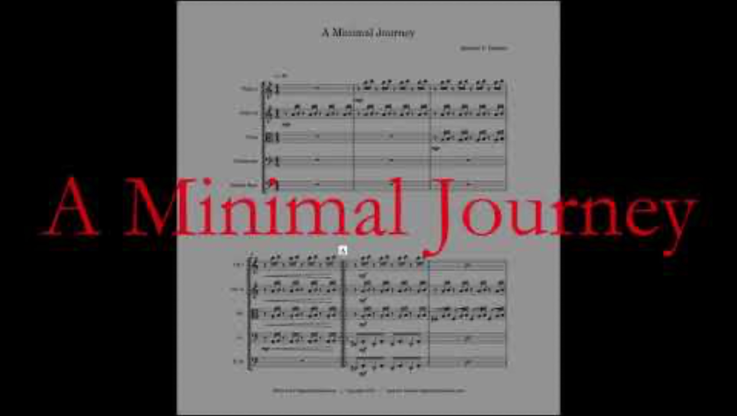

Slide 23
Conclusions
Palindromes, while not new, are garnering further interest in recent years
Proposed Terminology and tools are my take on what to do with palindromes
Applying techniques of Granular Synthesis from Electronic Music has advantages and challenges alike.
Palindromes exist on a spectrum ranging from pure notational palindromes to pure auditory palindromes.
Additional Considerations should be taken for rests, dynamics, articulations, etc.

Slide 24
What’s Next?

Slide 25
The Granularity of Palindromes
Dr. Zachary C. Daniels
Oklahoma City University
zdaniels@okcu.edu
https://zachdaniels.com/palindromes

